Slide 1
STORAGE STRATEGY

Slide 2
Types of storage devices
The records in databases are stored in file formats. Physically, the data is stored in electromagnetic format on a device. The electromagnetic devices used in database systems for data storage are classified as follows :
Primary Memory
Secondary Memory
Tertiary Memory

Slide 3
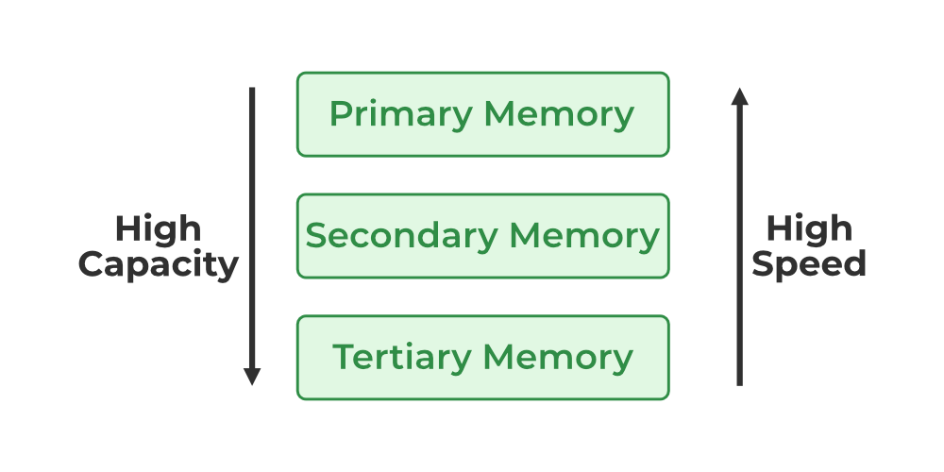
Types of storage devices

Slide 4
Primary Memory
Characteristics
Quick access
Volatile storage
More expensive
Types
Main memory
Cache memory

Slide 5
Types of Primary Memory
Main Memory: It refers to the physical memory that is internal to the computer. The word main is used to distinguish it from external mass storage devices such as disk drives that is in main memory.
Cache Memory: : The collection of data which is stored in a hidden or inaccessible place. A cache is a smaller, faster memory, closer to a processor which stores copies of the data from frequently used main memory. It is less expensive than system registers.

Slide 6
Secondary Memory
It is the storage area that allows the user to save and store data permanently.
This type of memory does not lose the data due to any power failure or system crash.
That's why we also call it non-volatile storage.

Slide 7
Types of Secondary Memory
Flash Memory: It also known as flash storage, is a type of non-volatile memory that erases data in units called blocks and rewrites data at the byte level. Unlike traditional hard drives, flash memories are able to retain data even after the power has been turned off.
Magnetic Disk Storage: It is a type of secondary memory that is a flat disc covered with a magnetic coating to hold information. It is used to store various programs and files. The polarized information in one direction is represented by 1, and vice versa. The direction is indicated by 0.

Slide 8
Tertiary Storage
It is the storage type that is external from the computer system.
It has the slowest speed.
But it is capable of storing a large amount of data.
It is also known as Offline storage.
Tertiary storage is generally used for data backup.

Slide 9
Types of Tertiary Storage
Optical Storage: An optical storage can store megabytes or gigabytes of data. A Compact Disk (CD) can store 700 megabytes of data with a playtime of around 80 minutes. On the other hand, a Digital Versatile Disc or a DVD can store 4.7 or 8.5 gigabytes of data on each side of the disk.
Tape Storage: It is the cheapest storage medium than disks. Generally, tapes are used for archiving or backing up the data. It provides slow access to data as it accesses data sequentially from the start. Thus, tape storage is also known as sequential-access storage. Disk storage is known as direct-access storage as we can directly access the data from any location on disk.

Slide 10
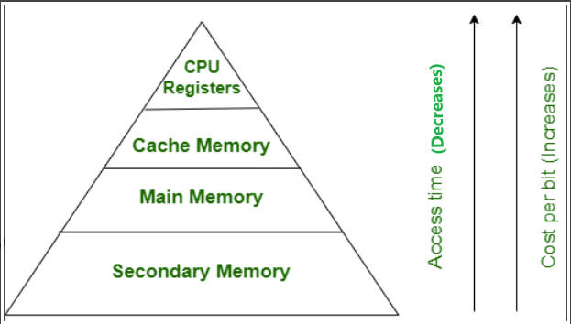
Storage Hierarchy

Slide 11
Storage Hierarchy
Storage media are organized on the basis of data accessing speed, cost per unit of data to buy the medium, and by medium's reliability. Thus, we can create a hierarchy of storage media on the basis of its cost and speed.
The higher levels are expensive but fast. On moving down, the cost per bit is decreasing, and the access time is increasing. Also, the storage media from the main memory to up represents the volatile nature, and below the main memory, all are non-volatile devices.

Slide 12
Thank You

